Slide 1
Detection of failures
Doug Curry
USPAS, January 2017

Slide 2
Machine Modes – segmenting the machine
MEBT Beam Stop
CCL Beam Stop
L-Dump
Accumulator Ring
Injection Dump
RTBT
Extraction Dump
Front-End:
MEBT Beam Stop
Beam operations can occur in areas that are ready to accept beam
Front-End
LINAC
LINAC
CCL Beam Stop
Target
I-Dump
E-Dump
Target
**all systems have to be made up
LINAC Dump
Downstream devices of beam destination are ignored

Slide 3
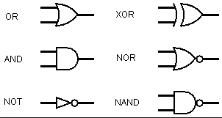
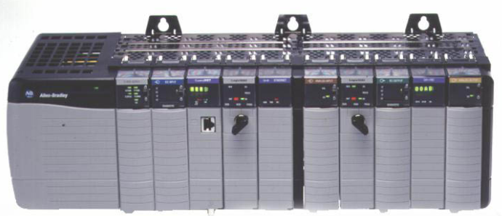
Protection methods
Fast Protection (micro-seconds)
Custom Hardware
Discrete logic, FPGAs, Operational Amplifiers, comparators
RF, pulsed magnets, BLM, BCM, …
Slow Protection (milli-seconds)
PLC
Gate valves, current transformers, water flow, …
Soft Protection (seconds)
Software
Magnet settings (~450 magnets at SNS), BLM voltage (Ion Chamber), …
Alarms
Human interaction, on the order of several seconds

Slide 4
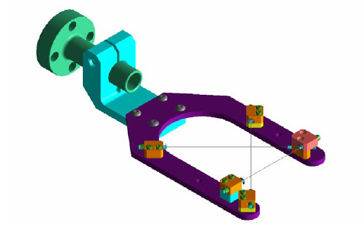
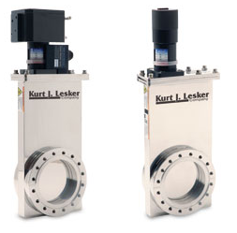
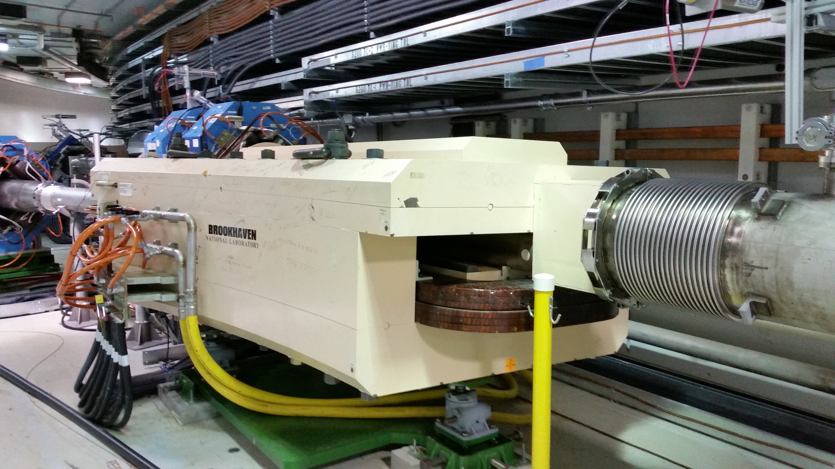
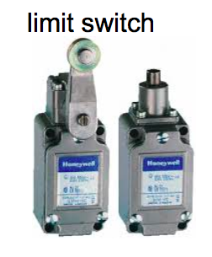
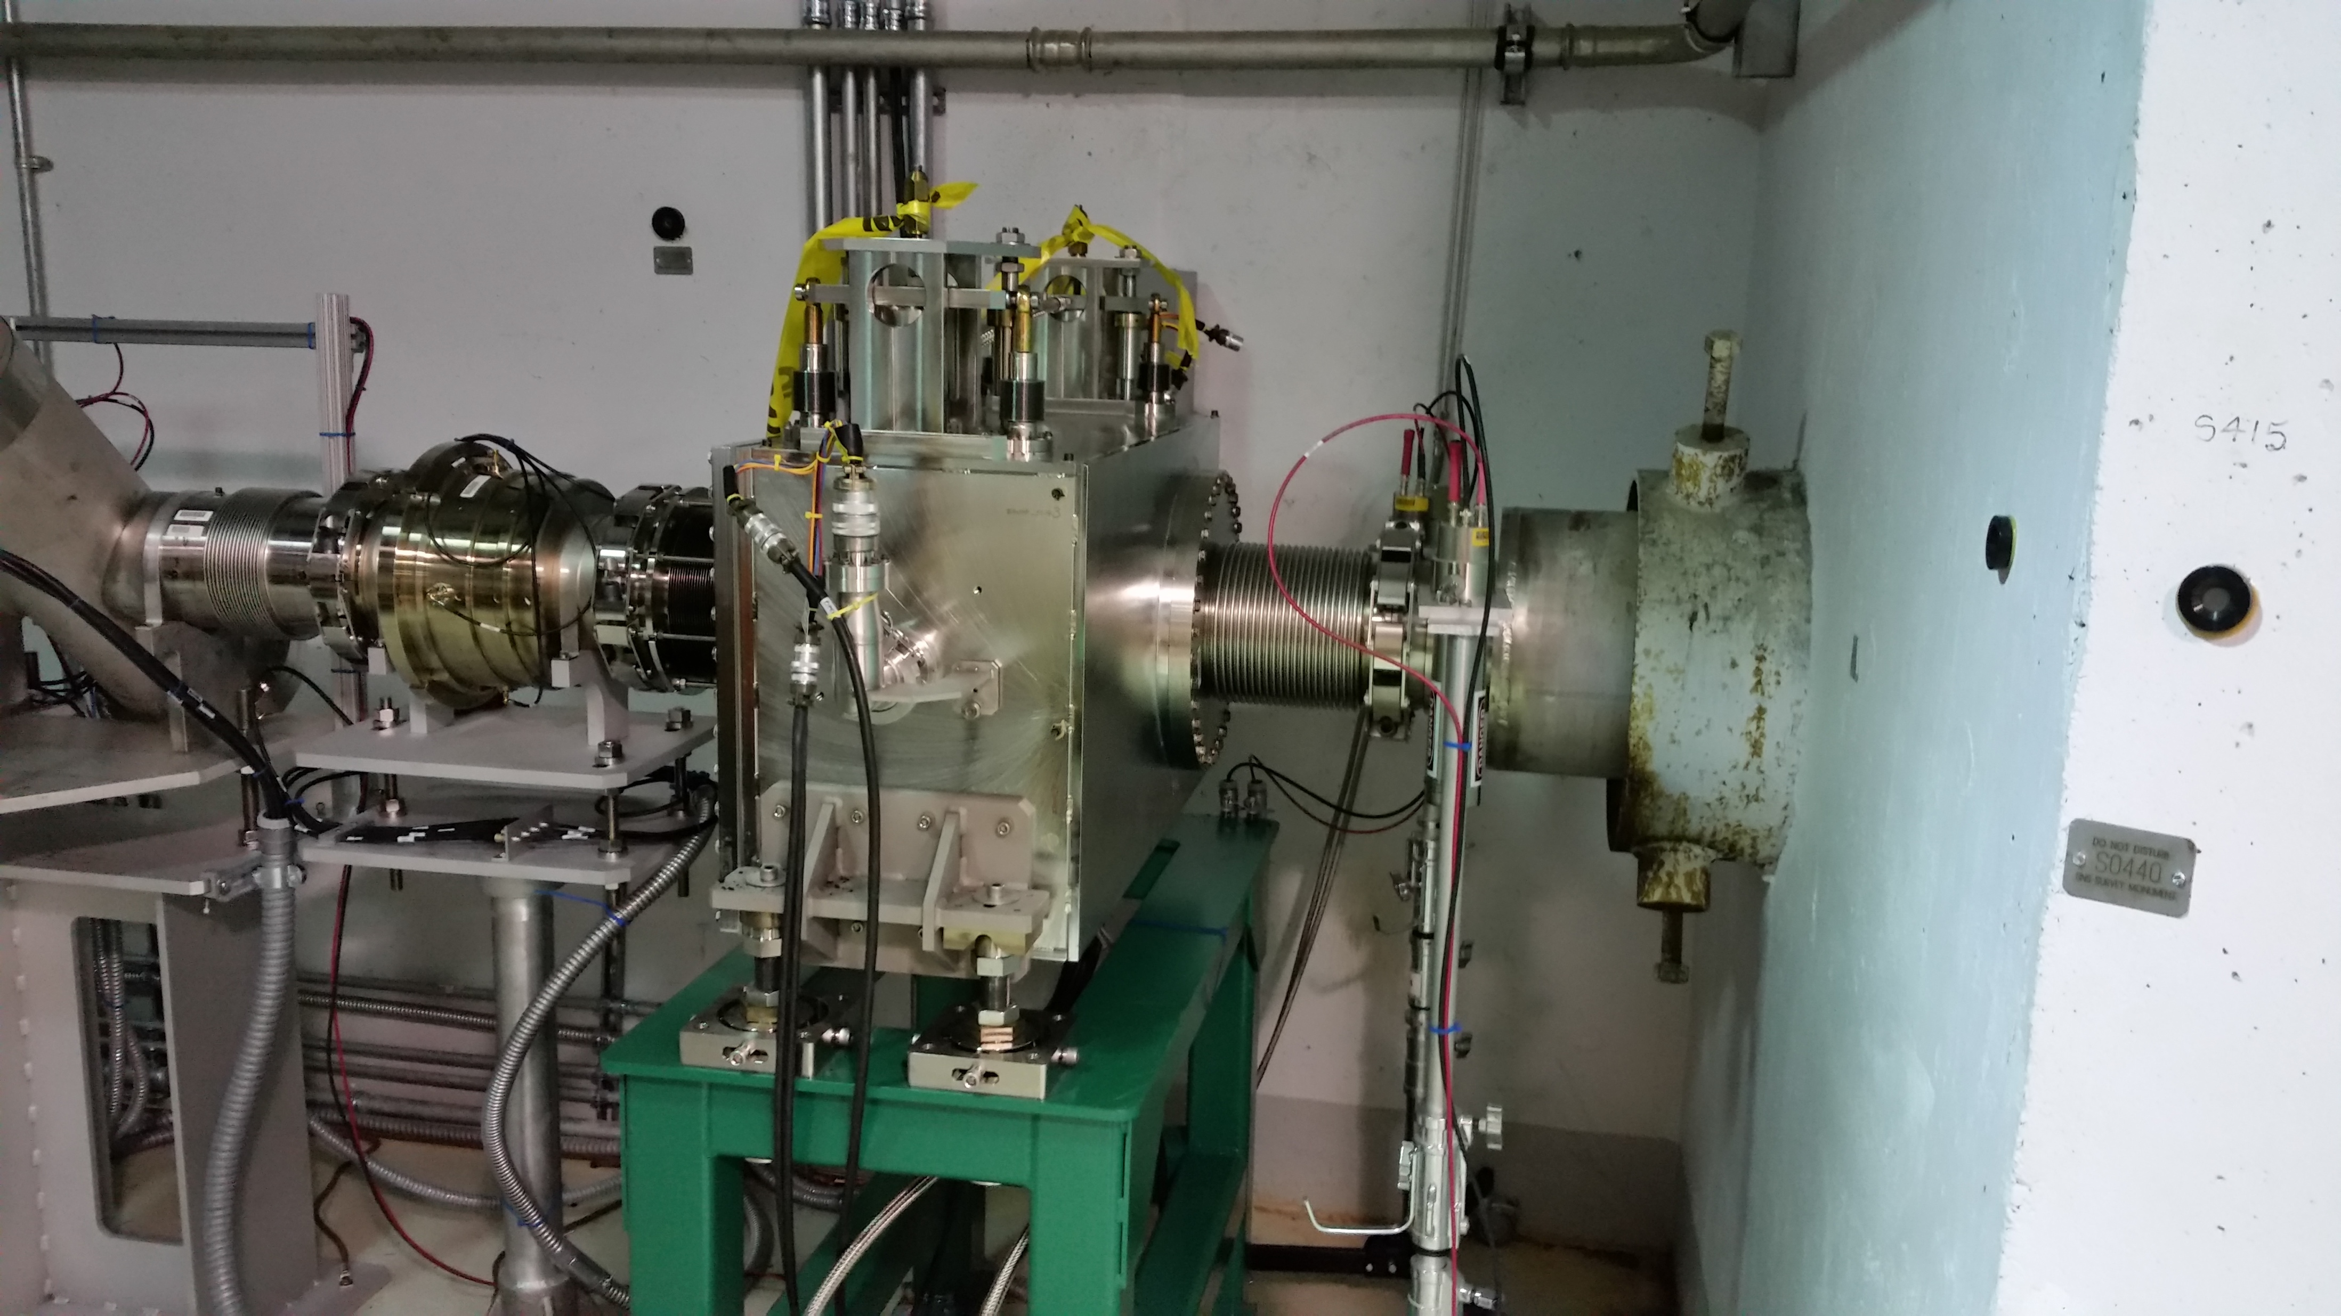
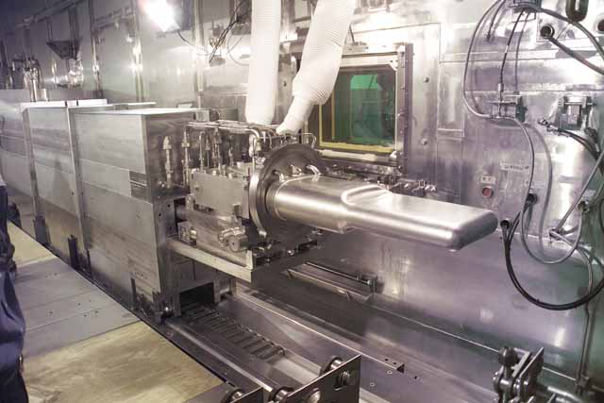
Is the machine location ready for beam?
Wire scanner
Extraction Septum
Limit switches
stripper stripper foil
gate valves
Beam Dumps
target

Slide 5
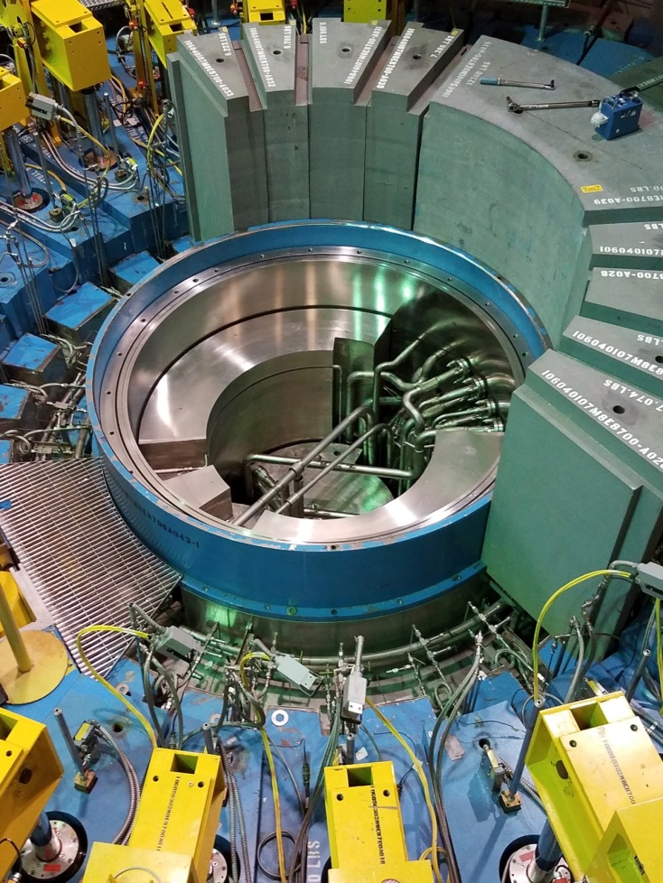
Water Leaks
Outer Reflector Plug
Inner Reflector Plug
Water
Slow
Interlock

Slide 6
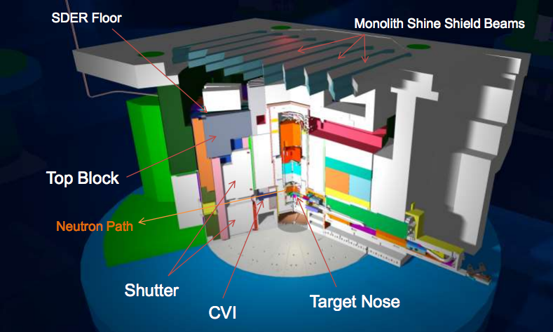
Target Monolith

Slide 7
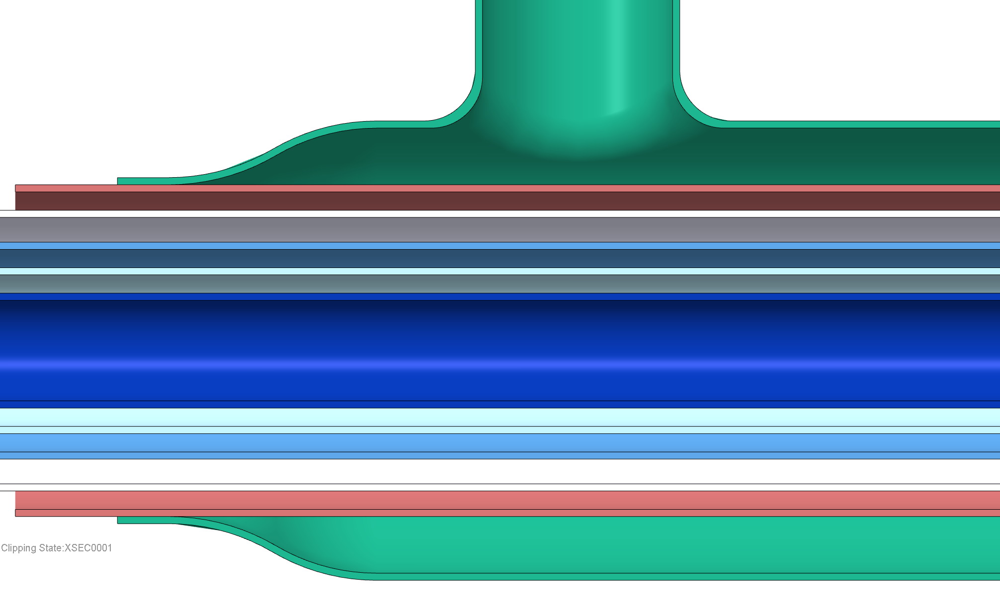
Failure identified…what now?
Pipe inside of a pipe inside of a pipe…
Shielding
High radiation area
Fillet weld sealing water annulus
Loop 3 light water flow
Core Vessel helium
Vacuum
H2 return
Vacuum
H2 supply
Helium annulus termination

Slide 8
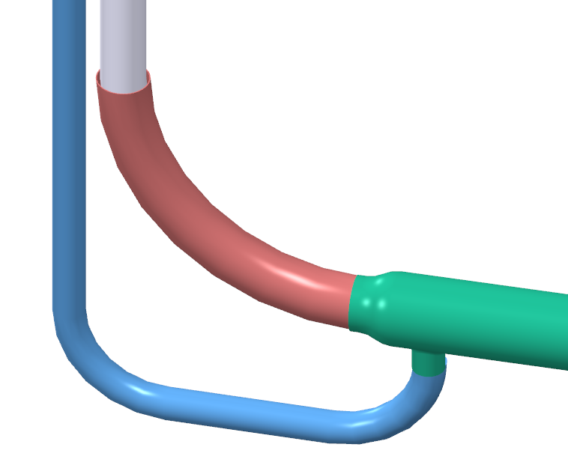
What now?
Helium annulus termination, water flowing from this location
The hydrogen transfer lines and associated vacuum envelopes are Passive Credited Engineered Controls in the Accelerator Safety Envelope
Filling the helium annulus with water changes the pressure conditions on the outer vacuum jacket, which requires analysis for possible remediation scenarios
Operating the core vessel with a humid atmosphere must be assessed for conditions such as galvanic action, corrosion, and so on
Water break off from transfer line
Water annulus termination weld to helium line
Top Downstream transfer and water lines

Slide 9
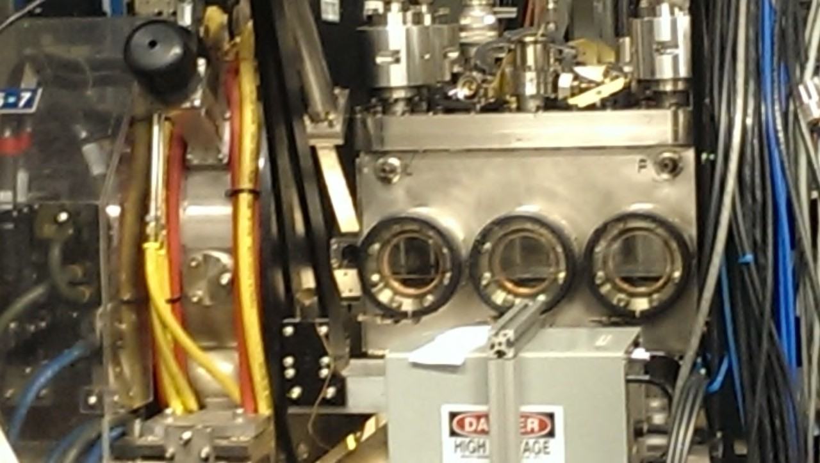
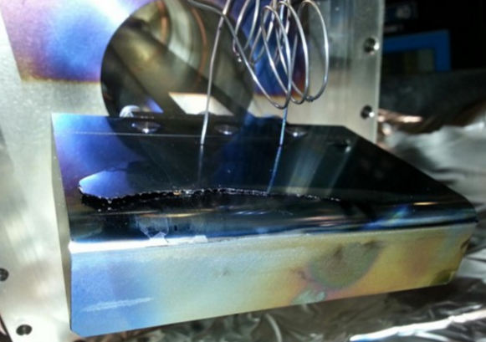
Water leaks
MEBT Chopper Target Failure
Internal beamline component
Complete disassembly of the MEBT
DTL GV was closed
No direct interlock
Vacuum??
MEBT Chopper
MEBT
MEBT
Chopper
Target

Slide 10
SNS Injection Region
Direct H⁻ and H⁰ waste beams to IDmp beam line
Merge H⁻ and circulating P beams
Where does the beam go without primary stripper foil?
150 kW capacity
To Injection
Dump
H⁻ beam from Linac
Thin “Primary” Stripping Foil
Thick Secondary Foil
Dipole magnets
_{H}-
_{H}0
p

Slide 11
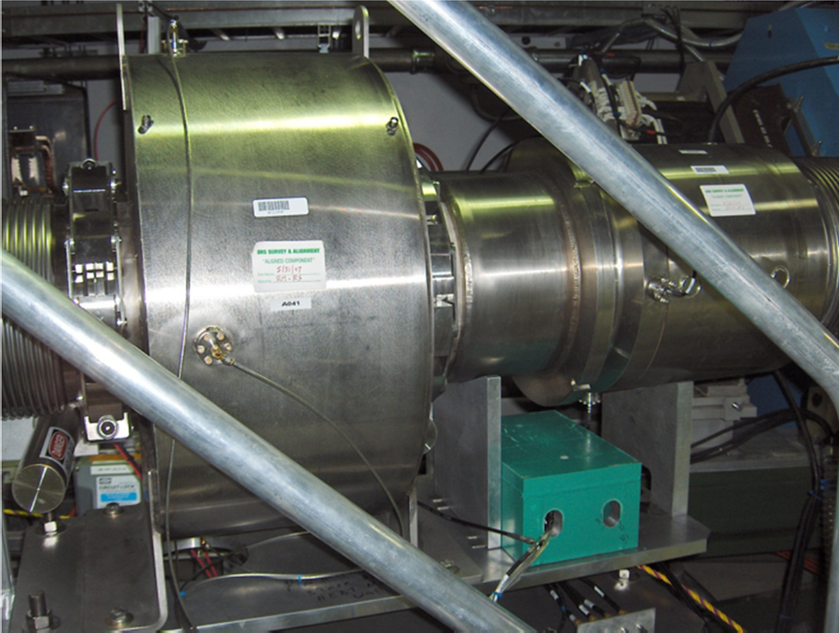
Beam Current Monitors (BCMs)
Nano Coulomb Detector (NCD)
100 kW Dump
Conservative
Example of a fast interlock
FPGA based
Large dynamic range
NCD
Torn stripper foil
Extraction dump

Slide 12
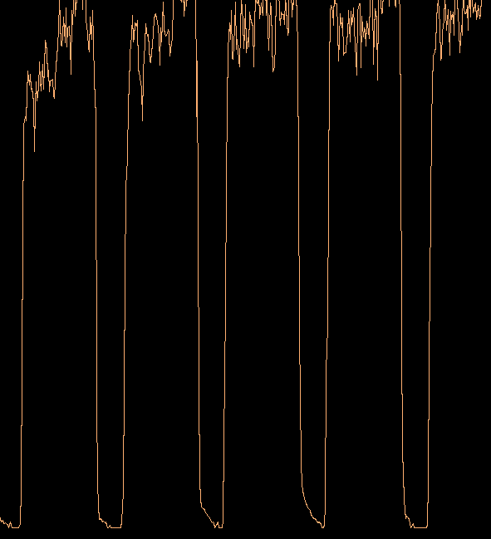
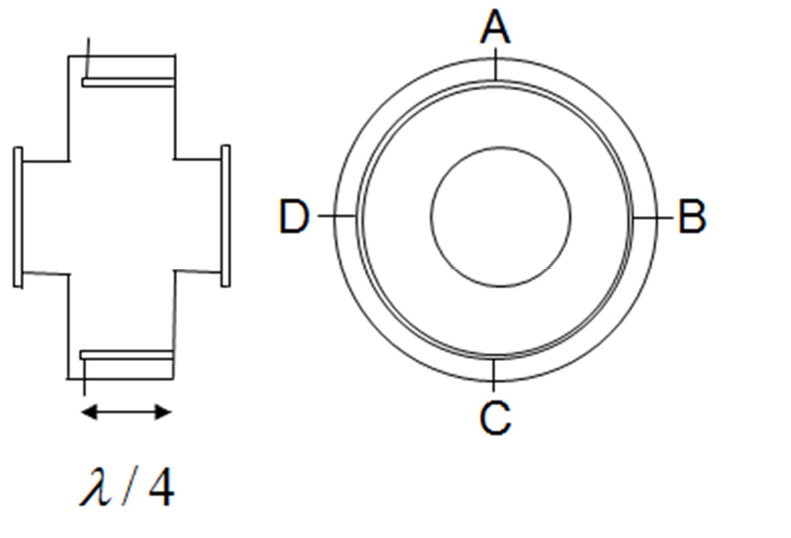
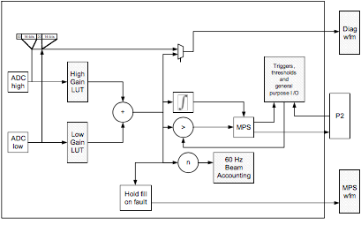
NCD (Nano Coulomb Detector)
1mA
A stripline design is optimized for beam response for a particular harmonic
Measuring capability
120 dB dynamic range
nA to several Amps
nA
4 electrodes
Calibration tables
Integrated power is verified against MPS threshold settings
Stripline BPM
Post mortem
waveform capture
C. Deibele

Slide 13
Beam Current Analysis
T
T
I(t)
I(t)
t
t
Ideal
Gaussian
$$I\left(t\right)=\sum_{n=0}^{∞}{Io δ(t−nT)}$$
$$I\left(t\right)=\sum_{n=0}^{∞}{ \frac{I_{o}}{σ\sqrt{2π}}e^{\frac{{\left(t−nT\right)}^{2}}{2σ^{2}}}}$$
Periodic Function
$$I\left(t\right)=\sum_{n=0}^{∞}{a_{n}cos⁡\left(nω_{o}t\right)}$$
$$I\left(t\right)=\sum_{n=0}^{∞}{{\tilde{a}}_{n}cos⁡\left(nω_{o}t\right)}$$
Fourier Series
For n$≥1$, $a_{n}$ is constant
$a_{0}={\tilde{a}}_{0}$ (assuming that the charge is constant)
$T=\frac{1}{402.5 MHz}≈2.5 nsec$
C. Deibele

Slide 14
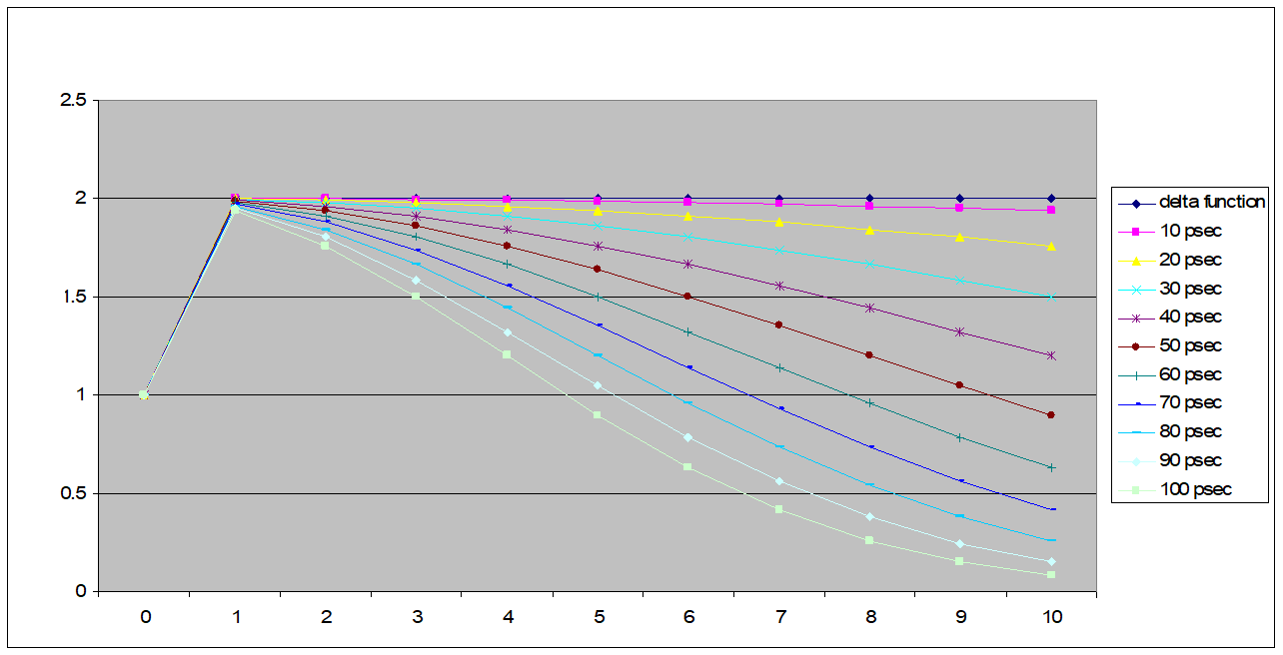
Infinite pulse train of current (constant charge)
$$I\left(t\right)=\sum_{n=0}^{∞}{Io δ(t−nT)}=\sum_{n=0}^{∞}{a_{n} cos(nω_{o}t)}$$
$$I\left(t\right)=\sum_{n=0}^{∞}{ \frac{I_{o}}{σ\sqrt{2π}}e^{\frac{{\left(t−nT\right)}^{2}}{2σ^{2}}}=\sum_{n=0}^{∞}{{\tilde{a}}_{n}cos⁡\left(nω_{o}t\right)}}$$
Comparison of relative magnitude between $a_{n}$ and ${\tilde{a}}_{n}$ versus $σ$
$$σ$$
$$a_{n}{,\tilde{a}}_{n}$$
C. Deibele
Harmonic Number n

Slide 15
Observations of Series Analysis
Results of $σ$ study
n=0 is unaffected, n=1 changes only by ~2% when σ varies from
10 psec to 100 psec.
It can not be expected to transport this wild range of $σ$ in the linac!
Assume FWHM varies by ~5%.
use the n=1 term, baseband emi can be filtered. ${\tilde{a}}_{1}$ can be considered constant for 5% variation of FWHM.
But, what is the detector?? It needs to be capable of a measurement
which is independent of beam position and is unaffected by emi.
C. Deibele

Slide 16
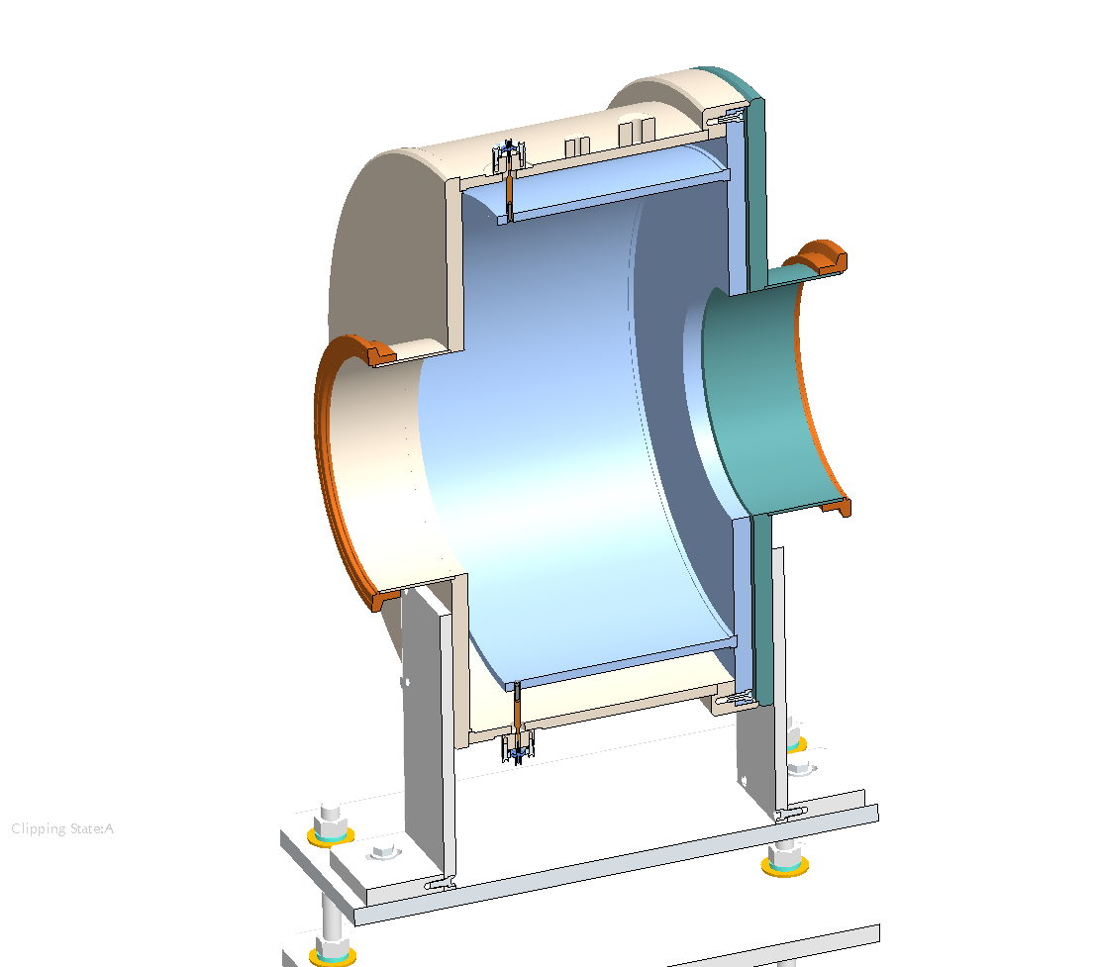
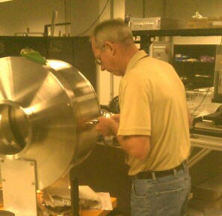
NCD Design
Nanocoulomb Detector
Assume I(t) has positional dependence w.r.t. time
$$I\left(t\right)=\sum_{n=−∞}^{∞}{I_{n}δ\left(x−x_{n}\right)δ\left(y−y_{n}\right)δ\left(z−βct−nT\right)}$$
Desire output to be independent of $x_{n}$ and $y_{n}$
Single Shorted Electrode
4 feed thrus give1% intensity variation on beam position over 95% of beampipe – HFSS simulation
Signal is combined using phase matched cables
Output= A+B+C+D
Has implications
S. McTeer / K. Gawne
Not described in this talk
A
D
B
C. Deibele
C

Slide 17
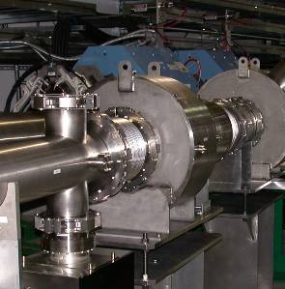
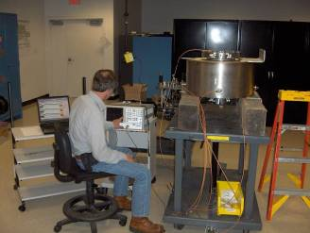
NCD Design
A
D
B
C
NCD was mapped using a NWA and
taught wire to simulate beam. The signal
error had a current measurement
(independent of position) in the beampipe with
a standard deviation of 1.3%
Total expected theoretical error is therefore
2.43% (connector/hybrid + bunch length).
C. Deibele

Slide 18
Schematic of Analog Hardware
Described next slide
Output of each section is logarithmically proportional
to beam current. Log-amps measure rf-power.
Calibration!
Each channel requires nonlinear signal processing to
merge the multiple channels into one.
Not described in this talk
Not described in this talk
C. Deibele

Slide 19
How a Log Amp operates
Output signal is proportional to the input power
Output is down-converted to baseband
Noise from nearby sources (Kickers, Magnet Supplies, etc.) is filtered out before the log-amp and does not affect measurement
Has an intrinsic rise-time
C. Deibele

Slide 20
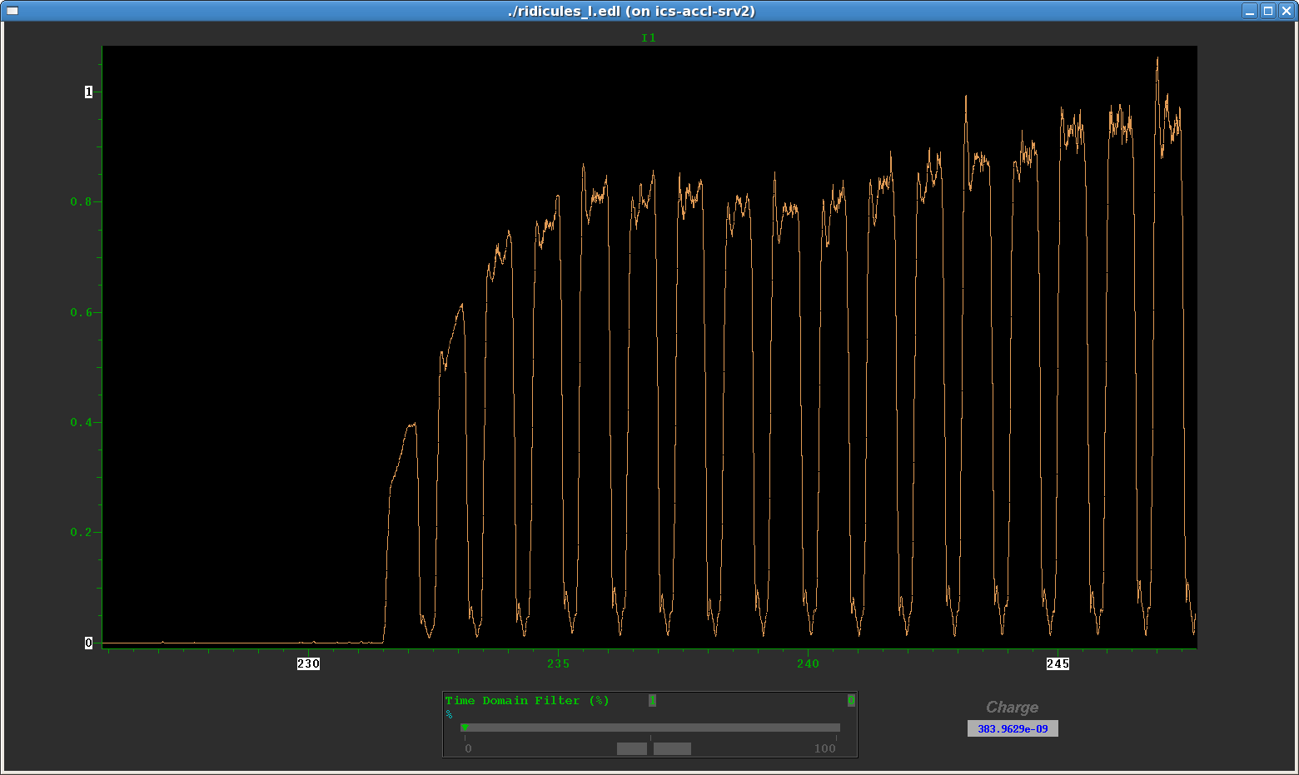
First Measurements
Reflections caused by head of beam minipulse
and the length of the cable round trip travel time.
C. Deibele

Slide 21
Schematic of Analog Hardware
Added circulator and single stub tuner for reflection
C. Deibele

Slide 22
After circulator and stub
Gaps are progressively getting smaller w.r.t. time purposely
Not all gaps are identical due to source issues
Note:
C. Deibele

Slide 23
Photograph of installation
C. Deibele
NCD
Combiner+Circulator+Stub

Slide 24
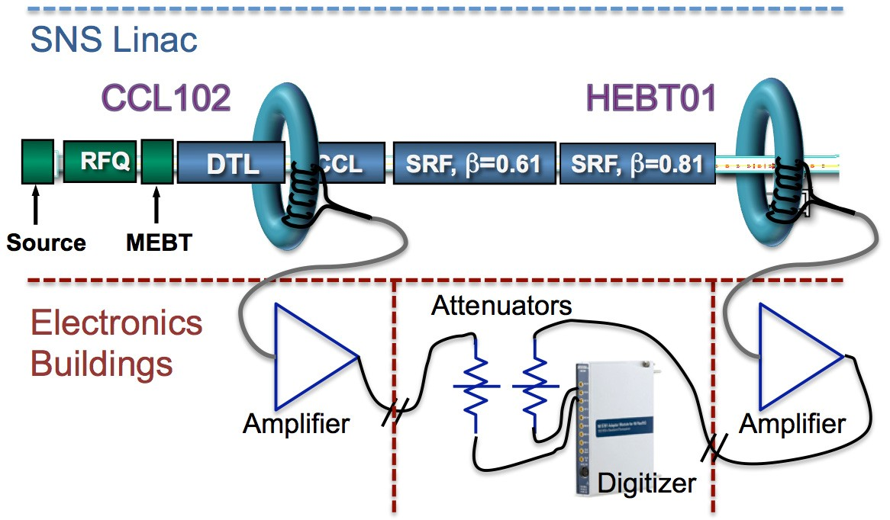
Differential BCM
Measure losses in the Linac
Example of a fast interlock
Beam loss

Slide 25
BLMs
Can stop accumulation
before extraction
Prevent next pulse only
Used at all facilities
Neutron detectors PMT/scintillator (DTL/CCL)
Ion Chamber (SCL → Target), argon filled
At SNS linac beam stops 20 – 30 us after BLM trip
If trip occurs upstream of or within the accumulator ring, can stop accumulation, but beam that has already accumulated will be sent to target – anywhere from small to full intensity
If trip occurs downstream of ring, can only prevent the next pulse from beginning the accumulation process
Fast interlock < 30 us total, includes BLM response time

Slide 26
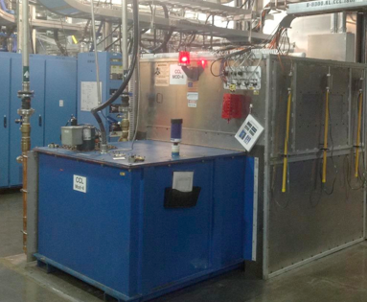
Dissolved gas analyzer
High Voltage Converter Modulator (HVCM) produce the pulsed power needed to power the klystrons
DTL Modulator
Impurities levels permitted arcing
Acetylene build up
Eventually sufficient quantities accumulated
The gas ignited causing deformation of the tank. The ½ inch (12.7 mm) steel plate bowed about 3 inches (76.2 mm)
Soft interlock is sufficient
Occurs over hours/days

Slide 27
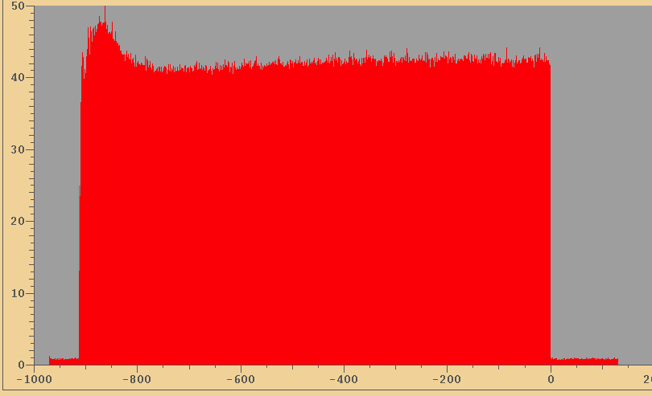
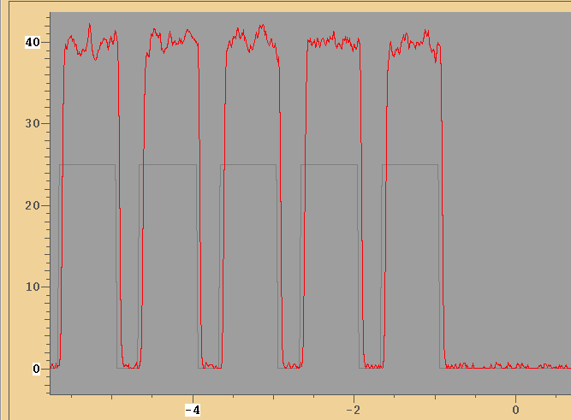
LEBT Beam in Gap measurements
−
Comp
CHuMPS (Chopper “und” MPS)
Fast amplifier with comparator circuit
Fast interlock
+
V Ref
Series of gates from the timing system generate the beam in gap checks
T Ref
Current (uA)
Ion source waveform
1 ms
no beam in gap
C. Deibele
Time (μs)

Slide 28
Pulsed Magnets
SNS Injection Kickers
Directly impacts the beam distribution on the target, too big, too small
60 Hz operation, 5M repetitions per day, 1.27B repetitions over 8 months
Waveform Monitors validate amplitude and timing
Fast interlock

Slide 29
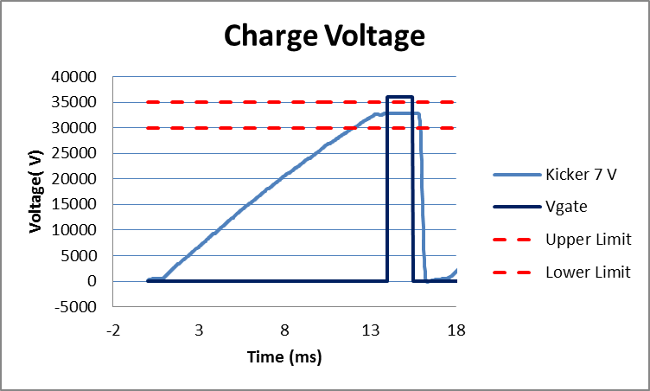
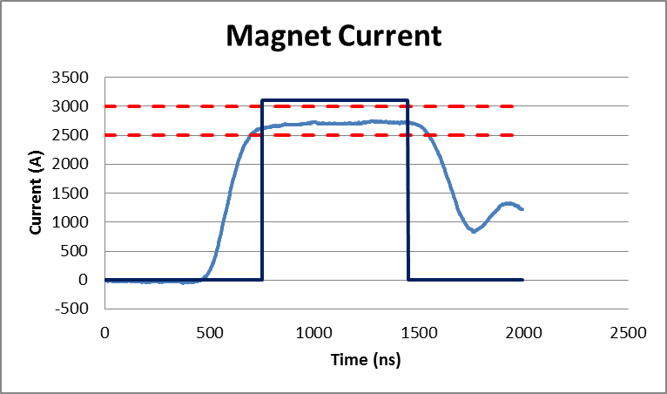
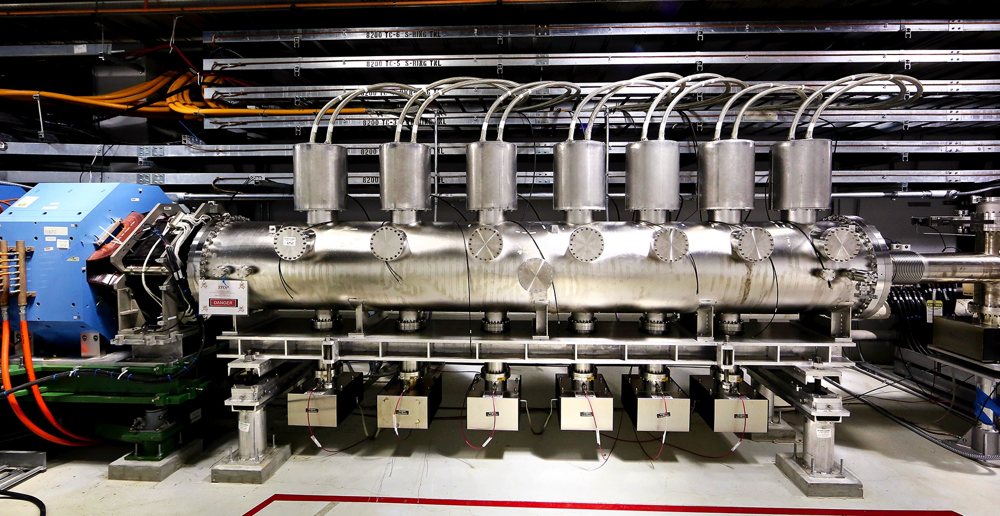
Pulsed Magnets
Extraction Energy | 1.0 GeV
Extraction Type | Single-turn
Flat-top length | > 700 ns
Extraction rate | 60 Hz
Rise time | 200 ns
Operating Voltage | -35 kV
Operating Current | -2.5 kA
SNS Extraction Kickers
Fast interlock
Typically
~ 695 ns
Ring Revolutionary period
1.0 GeV
945 ns
E-Kickers
8-14
1.3 GeV
911 ns

Slide 30
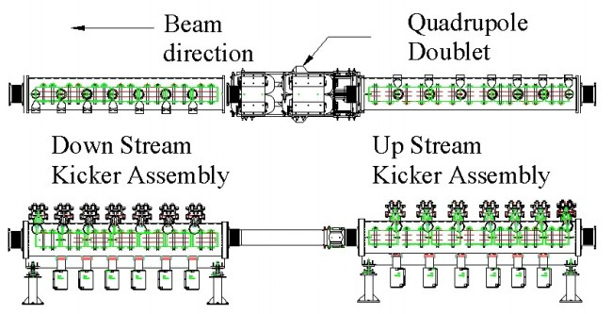
Pulsed Magnets
SNS
Extraction
Kickers
Misfiring Extraction Kickers
Usually isolated to a single kicker
Production periods run 13 of 14 Kickers
Hot-read spare kicker is run out of time 5 microseconds
Thyratron jitter and drift dominate failure modes
High power electrical switch
5.2 million cycles per day
Power supply failure
Timing reference
Temporary PLL jitter at the Timing Master
Results in all 14 misfiring “kick in the middle of the beam pulse
RTBT collimators are designed to intercept beams that are off-center due to extraction kicker mis-fires.
RTBT Collimator
Beam gap
~250 ns

Slide 31
Magnets
Example: SNS lock-down of RTBT quad and dipole corrector magnet currents
Magnet readbacks
Example of a Soft interlock
software interface with the MPS hardware
Trip limits set to +/-5% on quads and +/-0.5 A on dipole correctors

Slide 32
Magnets
PLC limits reside local to the system(s)
One system per destination change on large dipole magnets
Linac, HEBT, Ring, Extraction and Target
Current Transformers provide magnet setting levels
Values are locked in after tuning
Dependent on machine mode settings
Slow interlock
Extraction
Injection
Linac
Target

Slide 33
Magnets
Fast interlock

Slide 34
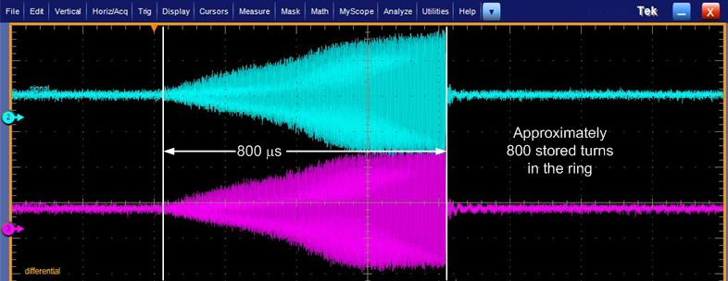
Magnets
Fast interlock
False reporting
Can prohibit reliable beam transportation
“Noise” Trips
Beam image currents
Power supply switching noise
Other miscellaneous sources
RF, transformers, long parallel cable runs, etc…
Beam image current

Slide 35
Insertable devices
Wire scanner
Position indicators
Beam measurement
Harps, wire scanners, faraday cups, etc..
Halo mitigation
Scrapper postion
Isolating vacuum
Gate valves
Limit switches
gate valves

Slide 36
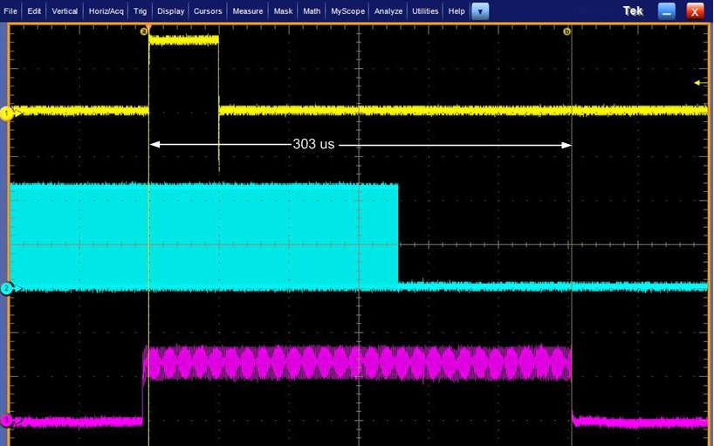
Cavity damage caused by slow MPS response times
Continued degradation of RF gradients
Eventually led to measuring MPS response times
Fast interlock ⇒ slow interlock
20 us design, operating at 200 us, order of magnitude above specification
Capacitors installed to mitigate false trips, additional charge sustained “good” operating condition for up to 300 us in some cases
Organizational Impacts
Lack of confidence in system
Degrading system performance…MPS problems again!!!!!
Damaged Cryo-cavities
BLM fault
MPS permissive
Beam Position Monitor

Slide 37
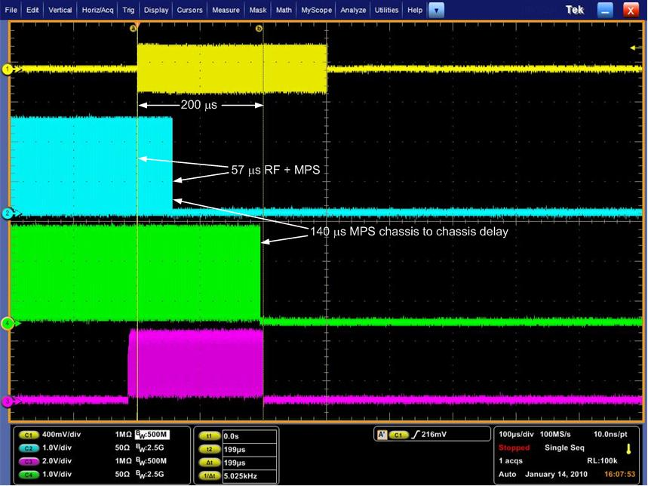
Cryo-cavity damage
Copper
link
Top
RF in
Sub-link
Main-link
Sub-link node
Main-link node
Fiber
links
Beam Position Monitor

Slide 38
MPS failure
Gated clock input stuck at “1”
Copper
link
Top
No reporting
Output enable stuck high
Provides a false MPS status to the top level node and permits continued beam production
Firmware implementation did not match the architecture approved by the review committee
Single clock source generated at the lowest node in the “chain”
Each node simply grants or prevents the passing of the permissive signal
Passed local clock source instead of original clock source
Introduced 2 failure points
Sub-link
Main-link
Local clock source
Fiber
links
RF
BLM

Slide 39
MPS IC failure
Caught by machine specialist
Noted BLM faults with no associated system faults
MPS and RF team performed independent tests and verified failure mode
Depth of problem is dependent on the number of nodes in the chain and the location of the fault
16 inputs per node multiplied by the number of nodes in the chain
Local clock source
Fault detected
✅ False status passed
Stuck at 1
Faulted node
Isolated to the individual node
16 inputs max
single clock source
Stuck at 1

